Slide 1


Mid-June
2025
Paris
France
Anyone else
absolutely distracted by
the scent of Tilleul
linden blossoms in
the air these days?

Slide 2

The scent of tilleul literally woke me up this morning coming through my window.
Encompassing and enthralling as the
City of Paris.

Slide 3
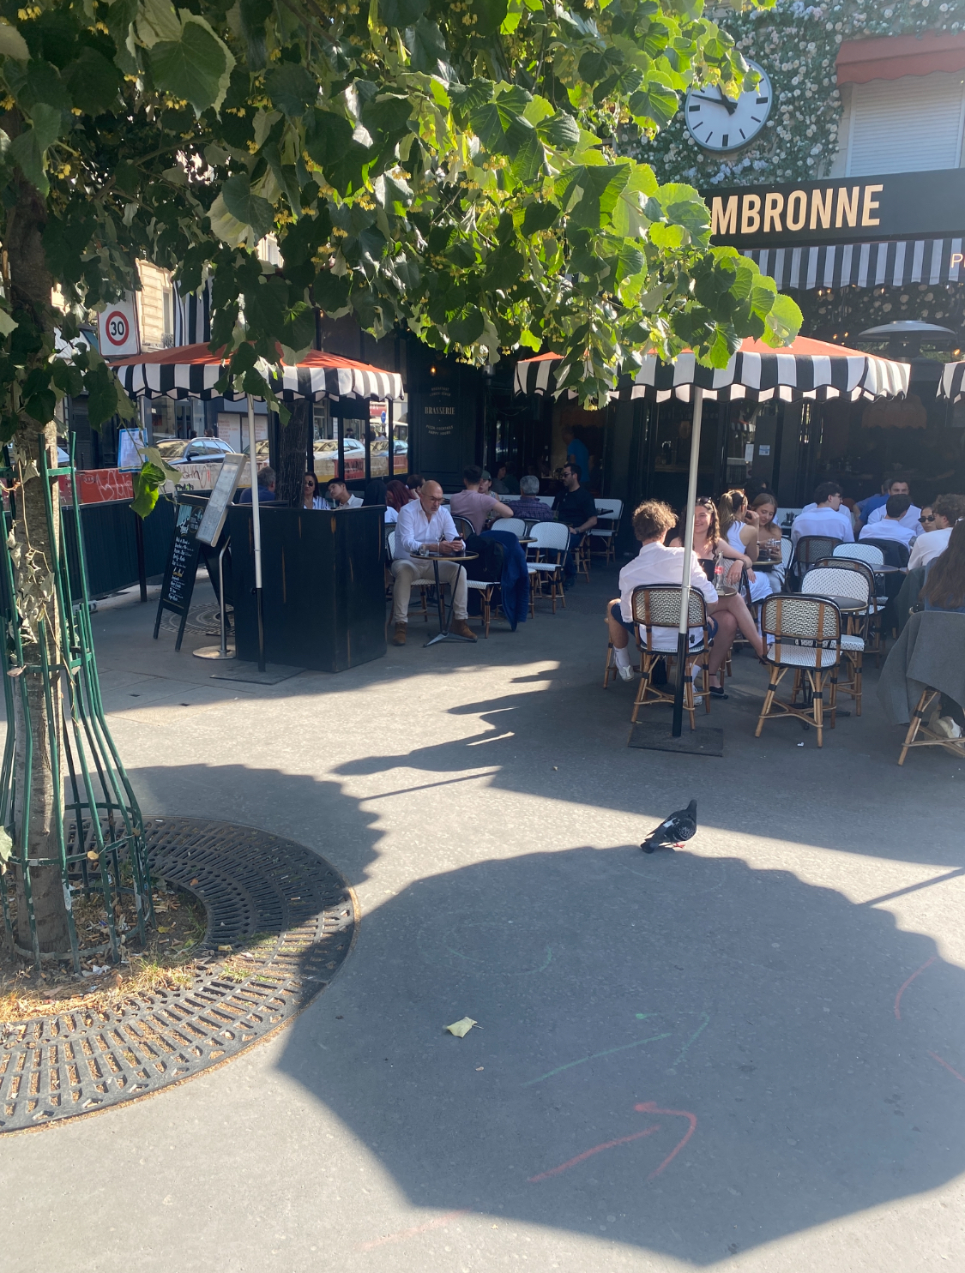
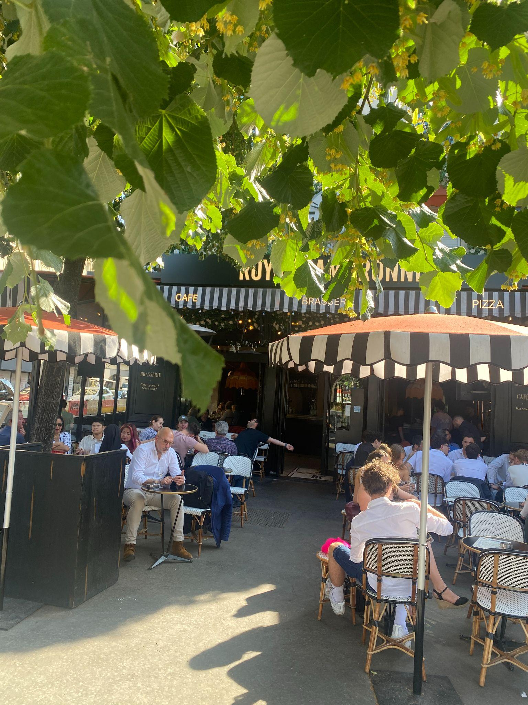
I recognized it immediately :
That golden heartbeat
halfway through the year
—
The one that makes all the
rest worth living…

Slide 4



I wanted to live it.
BE it.
Sitting at one of those tables
under the tilleul blossoms.

Slide 5
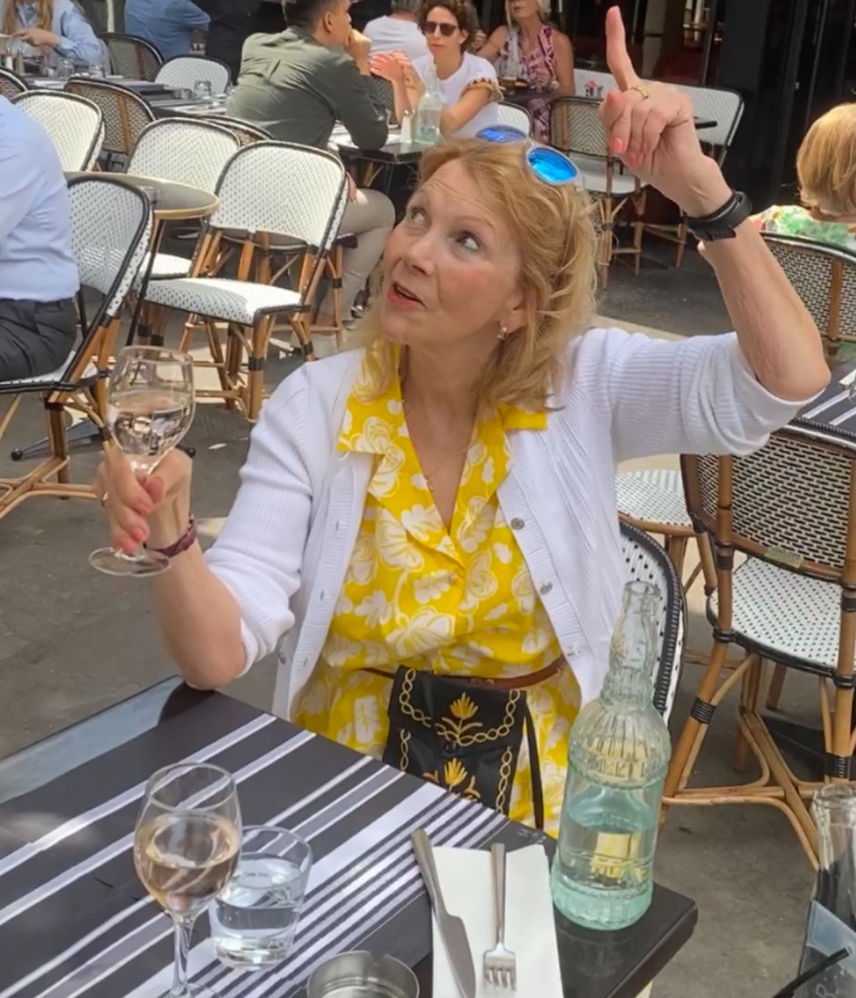
Only then
did Tilleul
reveal
the Duality of
her nature.

Slide 6
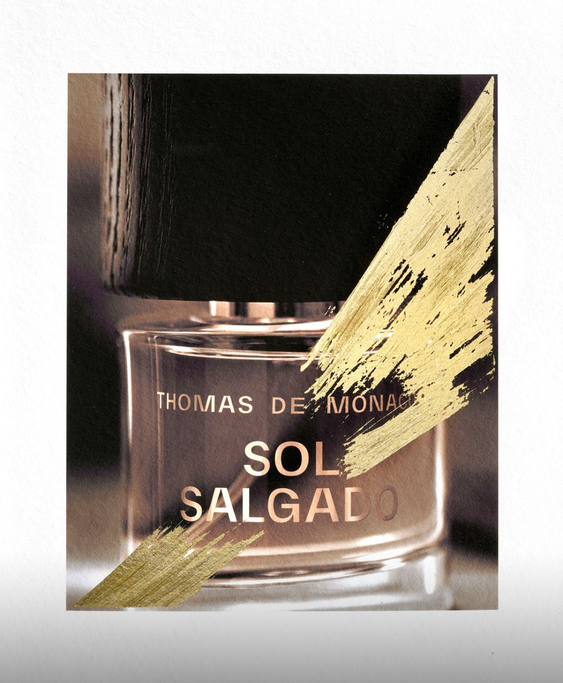
Sol Salgado by Thomas De Monaco
The blossom I can hold in my hand and bring to my face …
Delicate as a savonette
Shifting as light
Intoxicating as a drug
The scent of
personal human longing
Sol Salgado

Slide 7

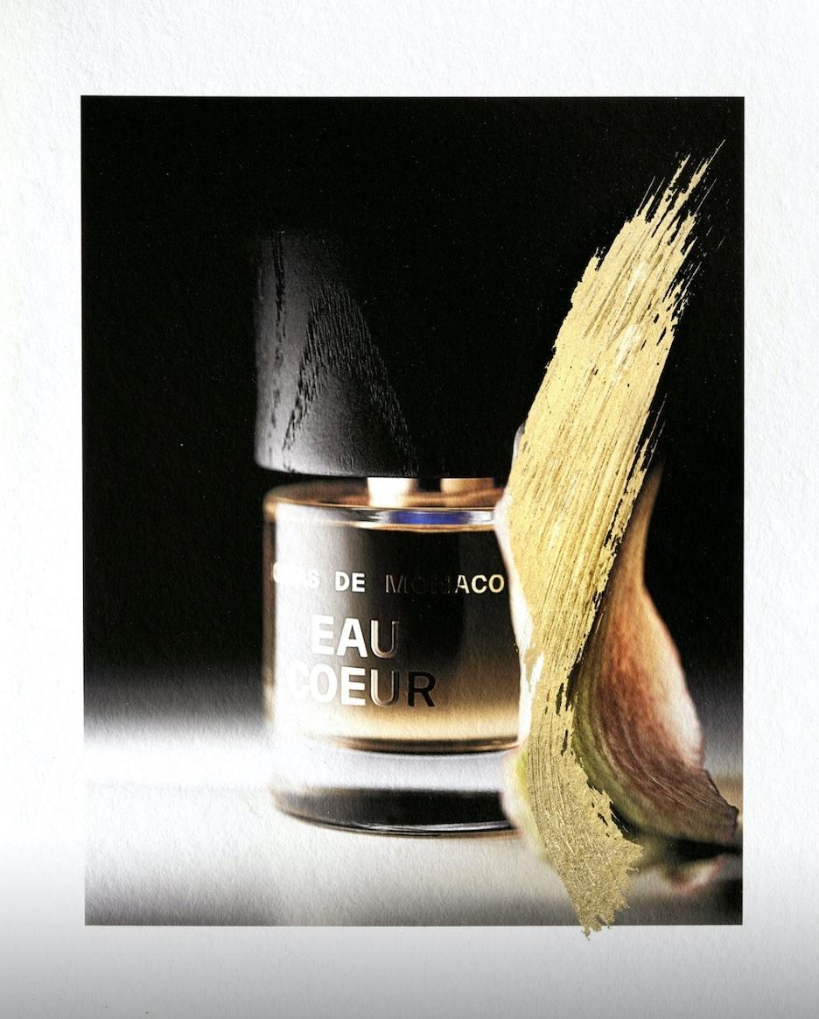
Eau Coeur by Thomas De Monaco
The scent that woke me — and an entire city — this morning …
Intense and grounding as
a lover’s embrace
Mysterious as the glance of
a passing stranger
The scent of
shared human longing
Eau Coeur

Slide 8
One flowering tree
Two scents and sensual experiences
Both part of the same invisible story
Tilleul
Sol Salgado
Eau Coeur

Slide 9
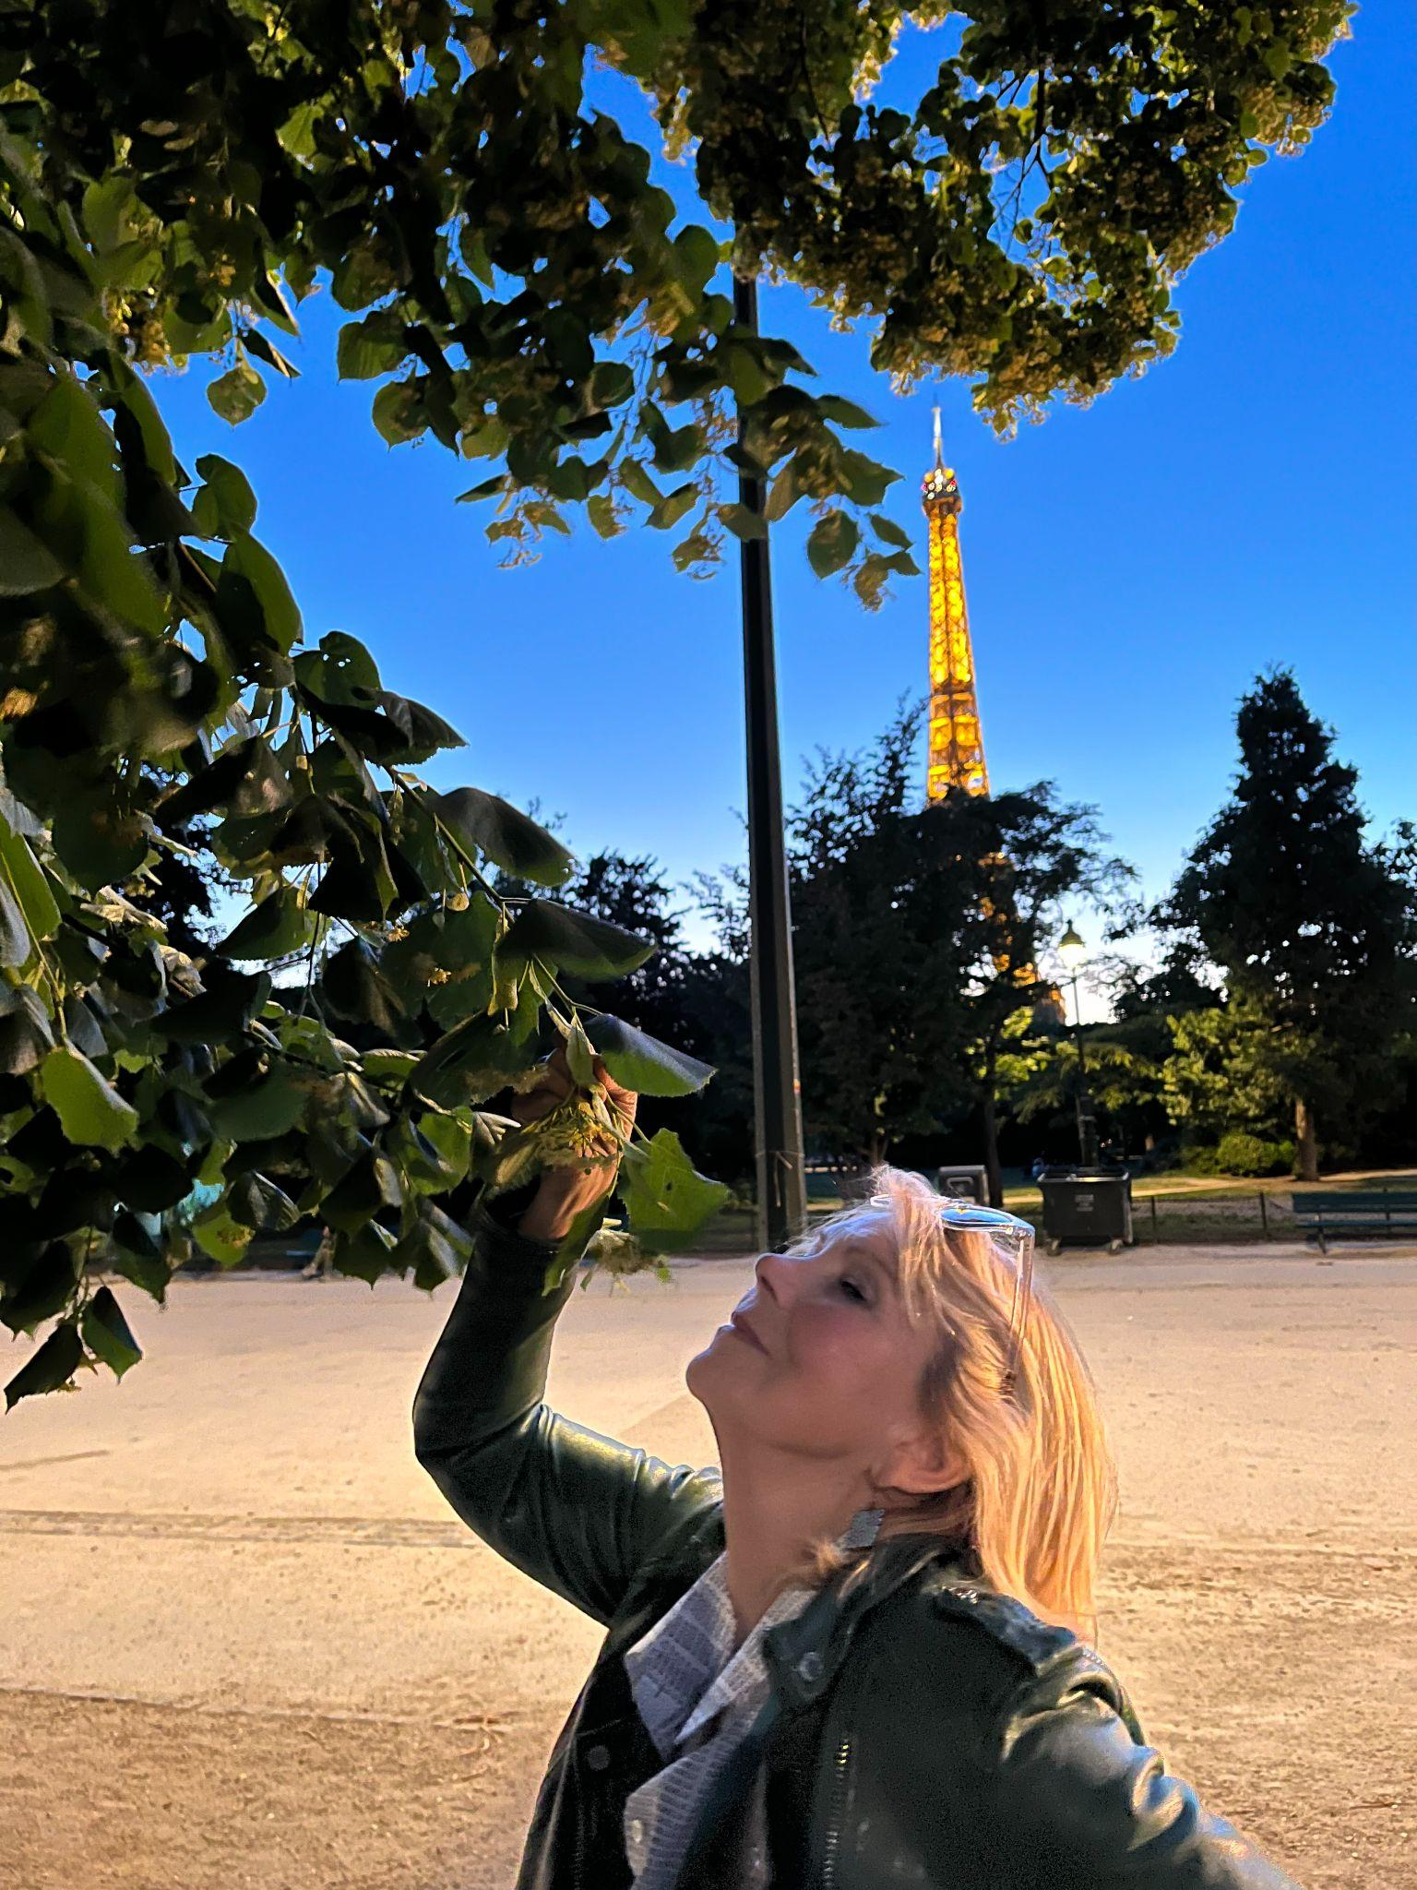
I seriously hope I never get over this experience.
- Sarah Colton
Paris in the time of Tilleul
June 17, 2025
P
Visuals featuring Sol Salgado
and Eau Coeur bottles
© Thomas De Monaco. Used with permission of
Thomas De Monaco Parfums
Sol Salgado
Eau Coeur

